Slide 1

MATURI VENKATA SUBBA RAO ENGINEERING COLLEGE
(An Autonomous Institution)
NOTES DEPOT
SIMPLIFIED LEARNING RESOURCE
Team members
B.VASANTH KUMAR REDDY (2451-22-733-311)
MOHD ZUNAID KHAN (2451-22-733-316)
​J. JAYASURYA (2451-22-733-314)
GUIDE:
MRS.M MADHURI
(ASST.PROF.CSE DEPT)

Slide 2
PROBLEM STATEMENT
Most of the students mainly engineering students face a problem with lack of resources like
Notes because most of us will neglect at initial stage and during exams we all will be in rush and
Start browsing for notes tutorial classes so "Notes Depot" stands as a dedicated educational platform crafted mainly for engineering students, aiming to simplify access to crucial learning materials and tutorial resources. This web application seamlessly integrates a robust backend built with Node.js and Express, utilizing MySQL for efficient data management. Through Notes Depot, users effortlessly access and download subject-specific notes sourced from a dedicated database. Moreover, the platform offers a user-friendly interface facilitating access to tutorial videos directly fetched from YouTube. Notes Depot makes BTech learning easy by providing organized notes and informative videos in one place. And in this BUDDY a chatbot was implemented by integrating an OpenAI API key ,with using this platform every student (users) can get each required resource at one place.

Slide 3

SCOPE
1.Providing notes on user selected subjects
2.Provide tutorial videos based on user search
3.Buddy for queries

Slide 4
APPLICATION AREAS
Academic Institutions: Notes Depot can be used by colleges, and universities to provide a centralized platform for students to access study materials, lecture notes
Self-Study and Exam Preparation: Individuals preparing for standardized tests, competitive exams, or professional certifications can use Notes Depot to access study guides
Remote Learning and Distance Education: In remote learning environments or distance education programs, Notes Depot can provide students with access to course materials, lectures, and resources, enabling remote participation and engagement in the learning process.

Slide 5



TECHNOLOGIES
1.HTML CSS JS to create a dynamic pages
2.NODE JS: (Node) is an Open Source, cross-platform runtime environment for executing JavaScript code
3.XAMPP MYSQL: storing of data
4.API (application program interface):
1.Youtube API
2.OpenAI API

Slide 6

TOOLS USED
1.Vs code editor:Visual Studio Code is a streamlined code editor with support for development operations like debugging, task running, and version control.

Slide 7
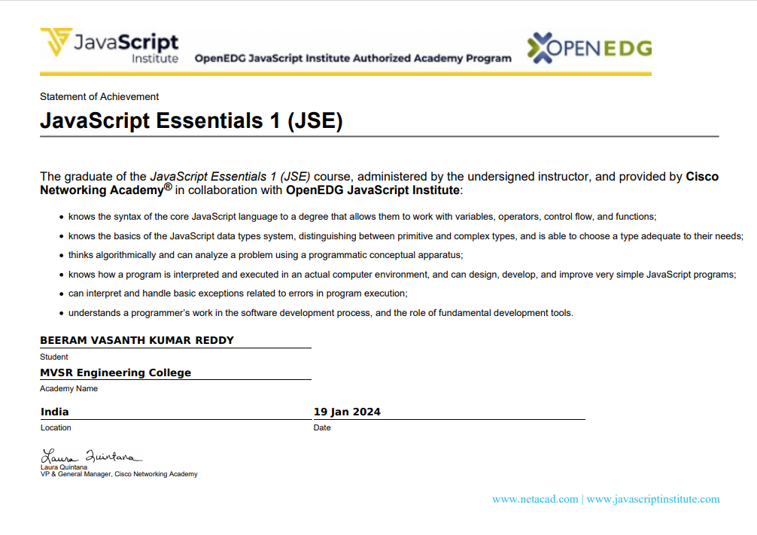
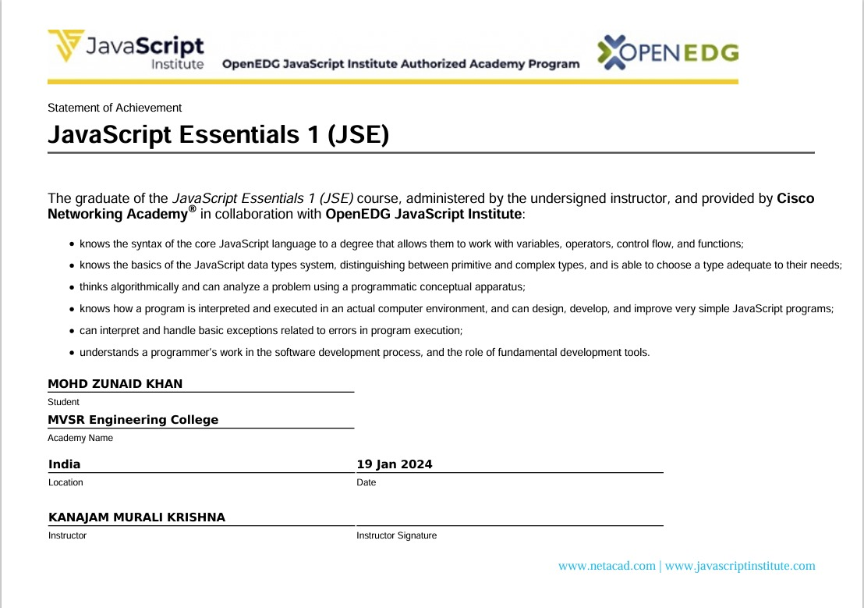
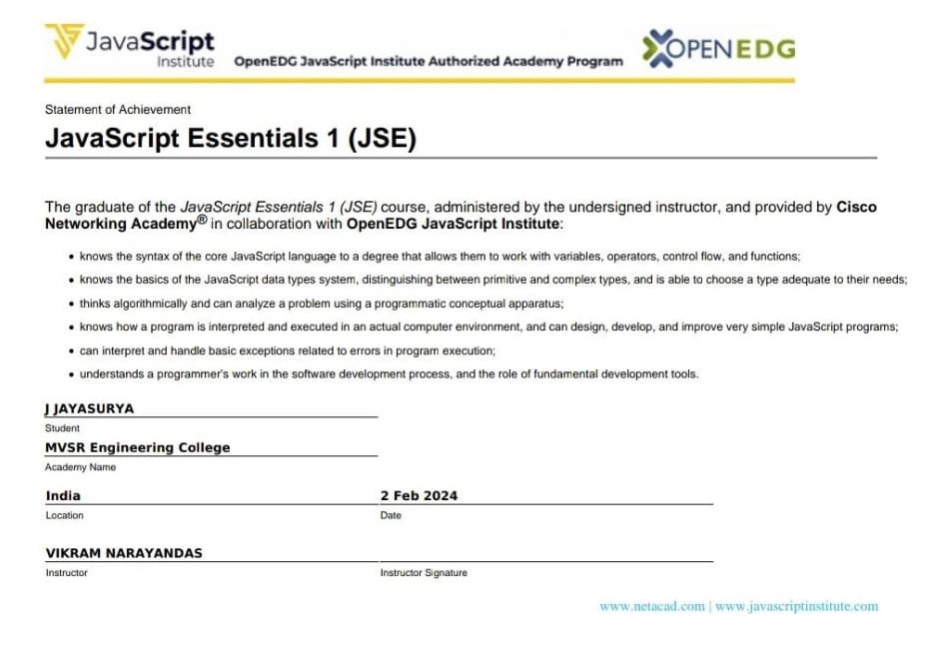
CERTIFICATIONS:
1. JAVASCRIPT cisco

Slide 8
IO SPECIFICATION
Year , semester, subject
topic Search
queries
INPUTS
OUTPUTS
Pdf of selected subject.
Tutorial videos
Give solution for queries

Slide 9
Sample Flowchart
START
NOTES DEPOT
HOME PAGE
NOTES PAGE
VIDEO PAGE
BUDDY PAGE
View and download
Get videos
Interact
With buddy for queries
End

Slide 10
implementation
Environmental Setup:
Development environment: used vs code IDE
API integration: Integration of YouTube API and OpenAI API set up required credentials and endpoints to API
Node.js and npm :installing node.js framework and npm pacakeges
2. XAMPP SQL Database

Slide 11
Modules and Description:
1. Express Server Module:
Description: This module sets up the backend server using Express.
It defines routes for handling user requests related to notes ,videos and chatbot integration.
2. MySQL Database Module:
Description: Manages the connection to the MySQL database, and
provides functions to perform CRUD operations related to notes.
3. YouTube Integration Module:
Description: Handles interactions with the YouTube Data API. Retrieves tutorial videos based on user requests.

Slide 12
5. Chatbot Integration Module:
Description:
Integrates a simple chatbot that allows users to ask questions and
fetches relevant information using the OpenAI API.
HTML/CSS/JavaScript Module:
Description:
Implements the frontend of the web application.
Users interact with the user-friendly interface to access notes and tutorial videos.

Slide 13
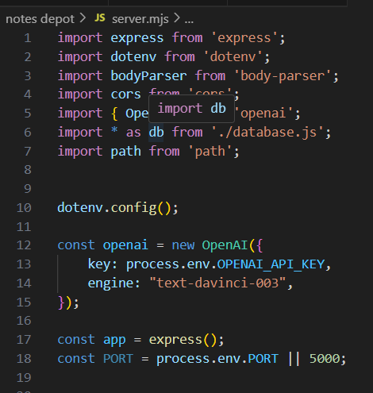
Packages used

Slide 14
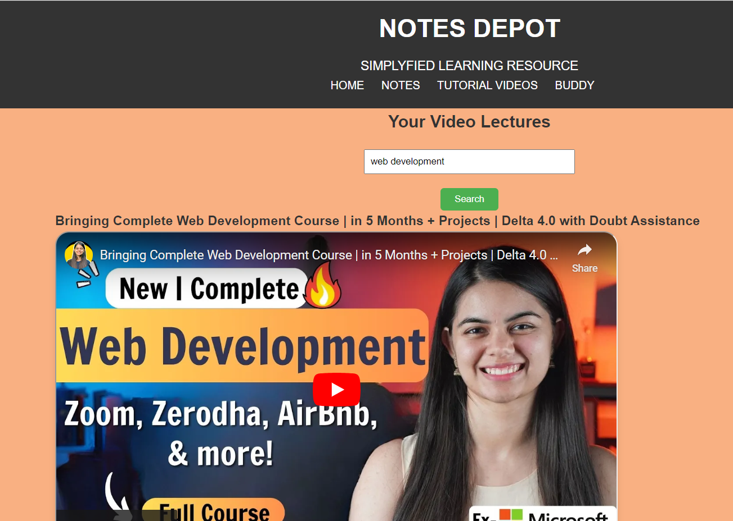
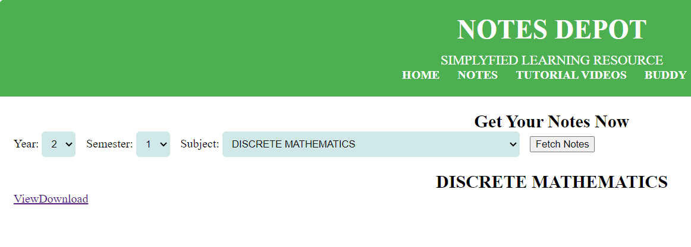
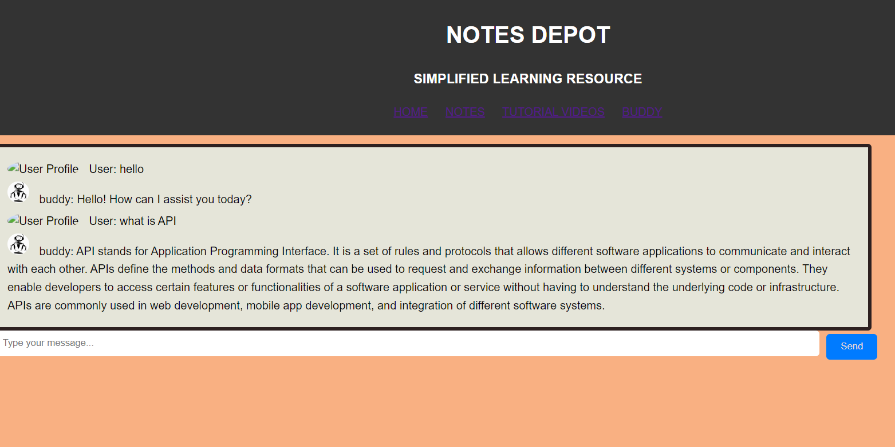
RESULTS

Slide 15
Future enhancements :
Content management system(for admins)
Progressive Web App (PWA): Convert the application into a Progressive Web App (PWA) to enable offline access, push notifications, and other native-like features on mobile devices.

Slide 16
THANK YOU

